Slide 1




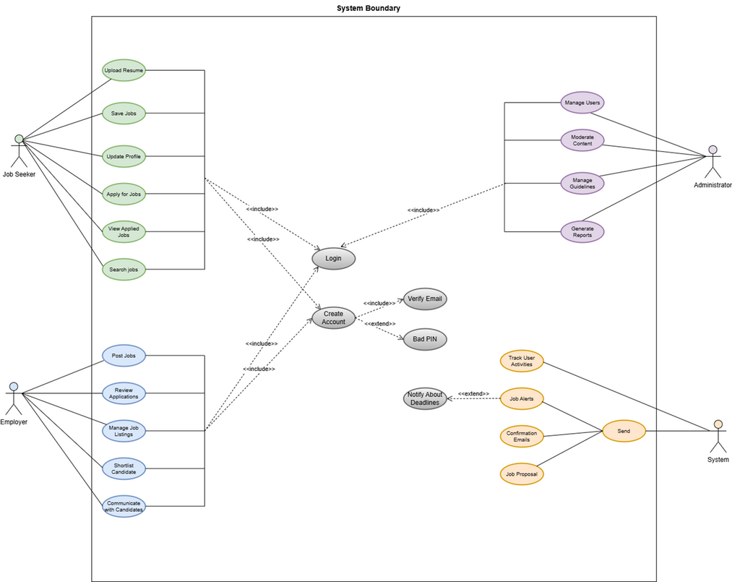
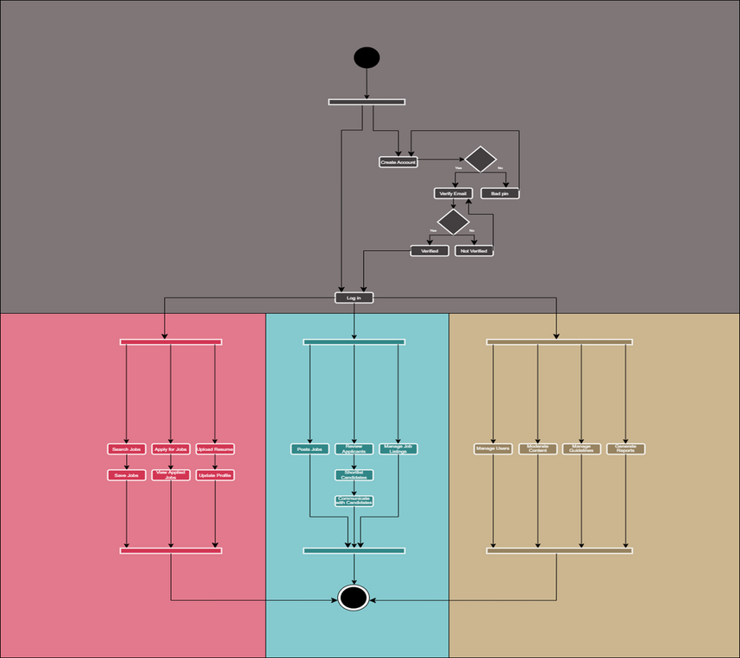
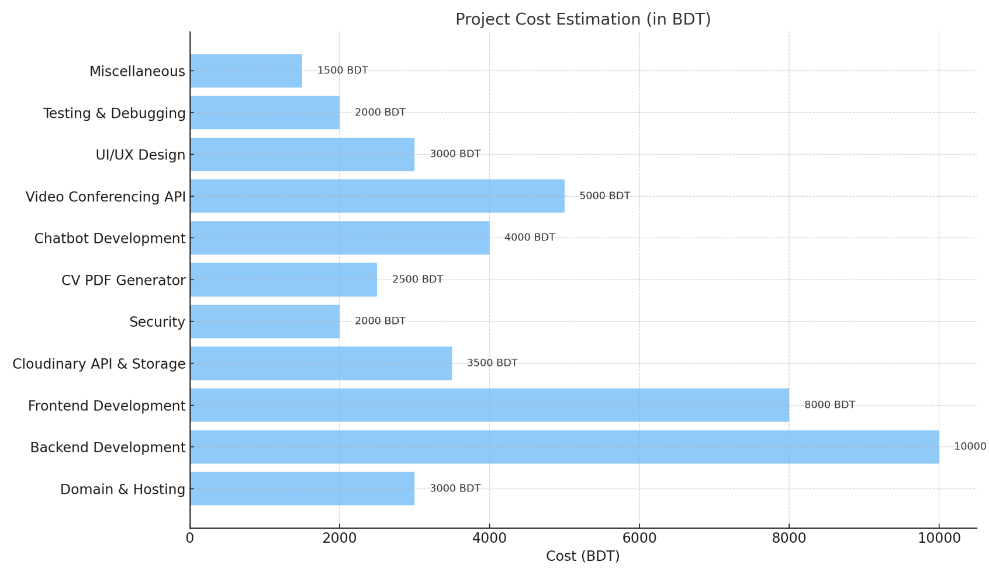












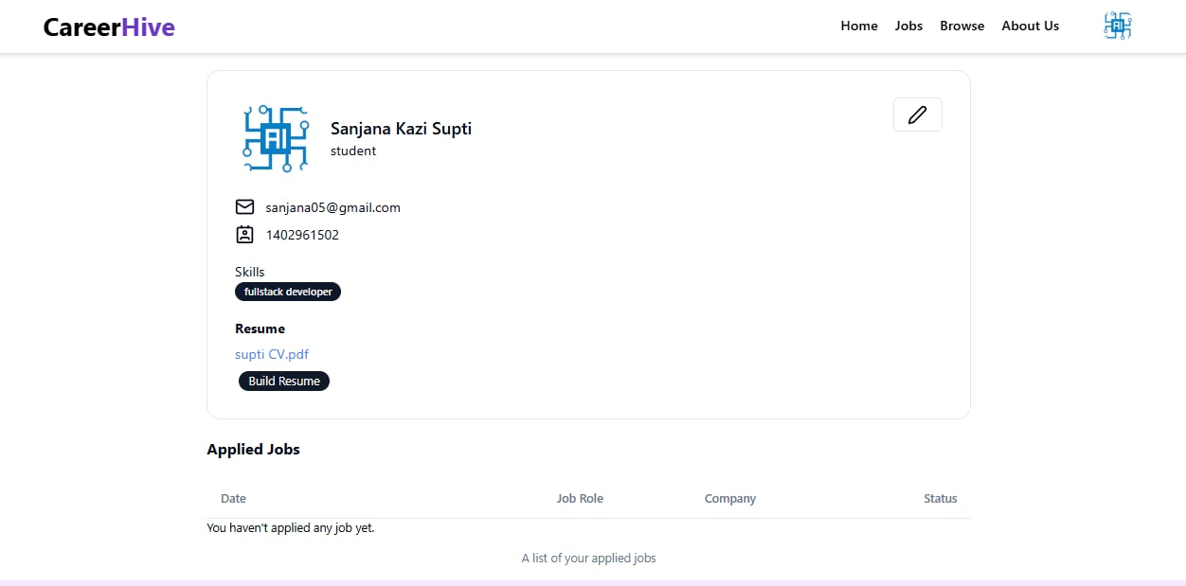
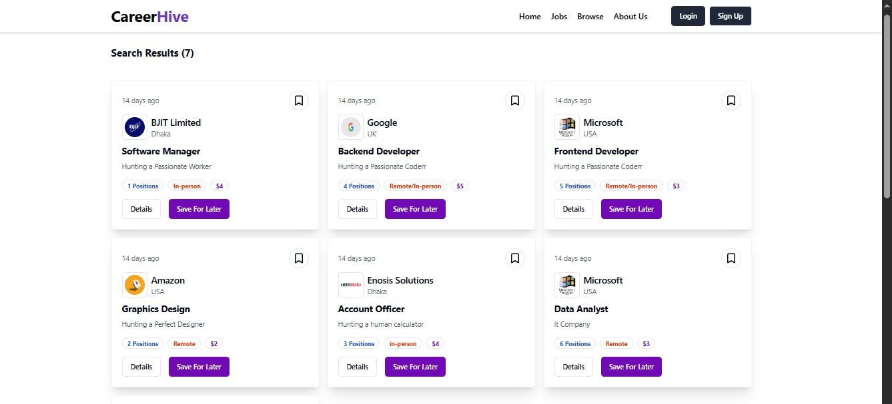

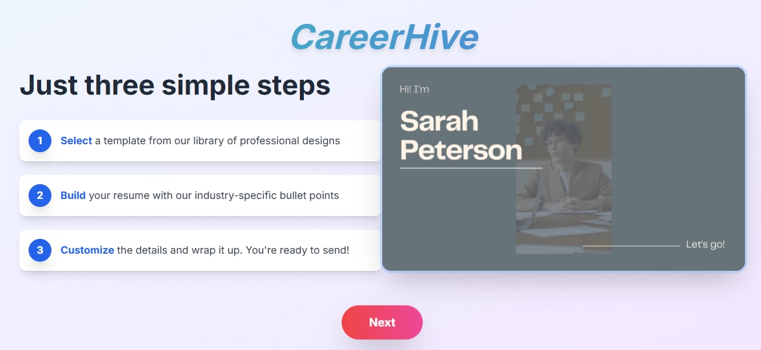



CSE412: Software Engineering
Unleash Your Potential — One Click to Begin
Nishat Tasnim Nilloy
LECTURER
Department of Computer Science & Engineering, East West University
Main Features
Use Case Diagram
Activity Diagram
▪
Sign up and Log in📌.
Users can use CV Builder.
Generate, save & PDF CV Uphold.
Chatbot suggests nearby jobs.
Users' address and details parsing.
Search and filter jobs with details.
Apply to a job.
View applied jobs.
Schedule and join interviews with video conferencing.
Interviewer's details and time parsing.
Time countdown included.
Mark job offer or rejection.
▪
▪
▪
▪
▪
▪
▪
▪
▪
▪
▪
Cost Estimation
Business Model
Technology
Freemium Model
Basic CV builder and job search features are free. Premium features (e.g., resume reviews, expert guidance) are monetized.
Employer Subscription
Companies pay monthly or yearly plans to post jobs, view applicants, and schedule interviews.
AI-Powered Matchmaking
A chatbot enhances user experience by recommending nearby jobs based on skill and location using address parsing and filtering.
Interview Scheduling Service
Integrated video conferencing with countdown timers boosts platform engagement and professionalism.
Advertisement Revenue
Third-party ads for training programs, resume services, and partner institutions generate extra income.
Group Members
Bushra Hoque
(2022-1-60-154)
Sanjana Kazi Supti
(2022-2-60-036)
Asif Ahmed Fahim
(2022-2-60-084)

